Slide 1
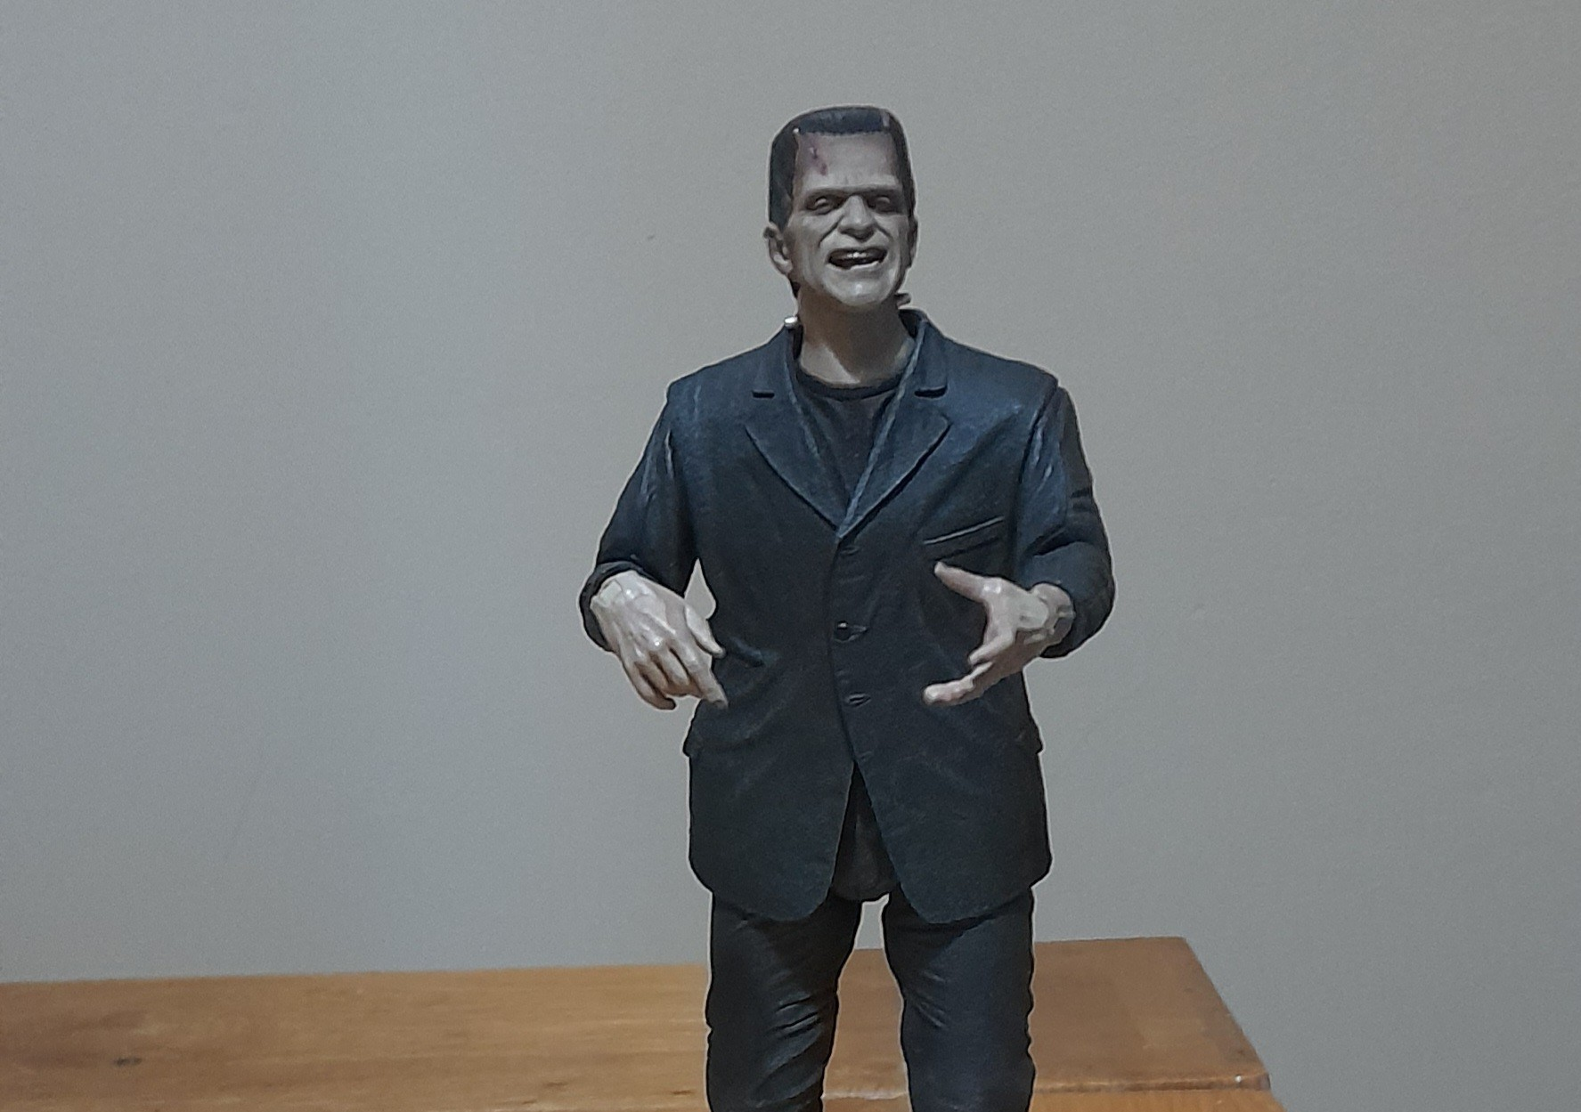
Can the monster help to make the dissertation more 'human'?

Slide 2
Rational And Pedagogy
Why the Monster? '...we use monsters to think about our "humanity"' (Bonnici, O'Connor 2020, p6)
Why this monster? '...defies category. He kills, is ugly but evokes symapthy' (Bloom-Bissonette, 2010, p108)
Teaching the monster - creating a tension/dialectic between emotional response and critical thought (Bloom-Bissonette)
Notes:
So why a Monster? I have been a specialist tutor working with neurodivergent students for many years now and in that time, I have supported many 3rd year students working on dissertations. Not all students experience the same ‘trauma’ but the over-riding impression they all give me is of being ‘haunted’. Hence, the monster.
Why this monster? I have had an affinity with Frankenstein’s monster since Childhood when I first saw the 1931 film with Boris Karloff in the lead role. (Not when it first came out!!). I was watching it with an elderly aunt, and the monster had just inadvertently drowned a little girl. My aunt said, ‘that poor creature’ and it was only when I realised she was talking about the monster that I remember thinking ..oh this is interesting. So I chose this monster because even though it has monstrous qualities, it is a complex creature and warrants further investigation. Much like the dissertation.

Slide 3
Key Learning Aim and skills development
Does the activity work? Does it help students to think differently about the dissertation?
Evidence of skills
Communication
Inspirational thinking
Research skills
Reflection

Slide 4
Pedogogical Hooks
Sympathy is an insuffient academic response based on a generative norm (Bloom-Bissonette, 2010)
Politics, art, science and religion help us to understand why monsters are created differently in different eras (Bloom-Bissonette, 2010)
Making visible things otherwise unseen and unknowable (Bloom-Bissonette, 2010)
Negative emotions can be as useful as positive emotions when learning to think critically (Meljac, 2018)
Process remains hidden so it's often a challenge to negoiate the multifaceted challenges of writing (Cardozo, 2006)
Notes:
The activity involved using a physical manifestation of the monster as a teaching tool. Originally, I planned to use the monster as a metaphor for the dissertation but after reading articles as part of my literature review I was persuaded to use the monster as the monster to promote the idea of asking students to articulate their initial feelings and emotions when confronted with this monster. Then ask them to reflect on why they think they might have these feelings. The theory being, this helps them to move from, just feeling sympathy or fear or judgement to analyzing why they feel this way.

Slide 5
The teaching activity
Participants - five 3rd year students
45 minutes allocated time
Worksheet for students for them to reflect on some basic questions about how they ‘feel’ about the monster. 5-10 minutes of silent writing time.
Followed by questions that were designed to make them ‘think’ about why they feel these particular emotions
Explore their prior knowledge and experience of this monster and monsters in general.
Evaluation – what was good and bad about the activity? What could be done differently?

Slide 6
Methods
Fieldnotes based on participatory observation. Emerson et al describe field notes as ‘experience + observation = text’ (1995). Notes of what I observed during the activity, and the students' written comments made up the data.
I was very mindful of my positionality as their tutor as well as the resercher and the power dynamic involved. I already work with the students.
This power dynamic and the potential for bias in the interpretation of the data made me mindful of the need....’to understand how an observer/researcher sits down and turns a piece of her lived experience into a written piece of text’ (Emerson et al, 1995,)

Slide 7
Theme one - How lived experience of the monster influences perceptions. Cultural/social contexts.
Only one student did not know the story of Frankenstein. Had no fear of monsters and believed they were media creations to play the bad guy. Thought they had no cultural value although referred to the importance of monsters in their parent's African culture
Another student referred to the prevalence of Troll mythology in their childhood and believed that mythology plays a very important role in society as a means of explaining evil and human experience. This student described herself as having an addictive relationship to cortisol.

Slide 8
Themeone (cont.) How lived experiences of the monster influences perceptions.Social/cultural contexts
One student referred to the monster as a point of struggle. The monster looks human. They had read the book at school and remembered it as a play between life and creating life. Embodying human experience. How other people look at you. Perception. The yuck of others, yuck of self. They had an affinity to the bad guys in films. More interesting. Now sees monsters as laughable. More value when younger. A point of comparison. Creates comfort. A scale between good and evil. A cautionary tale.

Slide 9
Theme two- Evidence of dissertation anomie. How students find their writing voice (Cardozo, 2006)
Two students talked about the fear of the unknown.
One said, It's just the burden it is. I’m good at expressing ideas in different ways
One said It can be daunting and very scary, especially as writing is not a strength. Fear. Not knowing what to do. They then evoked the concept of the monster and said maybe it's like picking things apart and not being scared. ‘Its not going to kill me’.

Slide 10
Theme two- Evidence of dissertation anomie. How students find their writing voice (Cardozo, 2006)
When asked if the dissertation ‘lurked’. One student said. ‘Yes, yes, yes!’ Two talked about their imagination blowing things out of proportion. One going on to add that their imagination was good, but they hold themselves back as doesn't want to try and fail. They then said. ‘I am capable. I can get through it'. Another remarked on how much she enjoyed the research.
When asked if the dissertation had a shape. One said. ‘A rectangle. A big book. A very regimented shape. Want to chisel into it and add moldings. Make it beautiful.’ This student had previously described themselves as a slow reader, seeing reading as a challenge as there are so many ways to go with the theory.

Slide 11
Student Evaluation – what was good?
Perfect! Reminded them of a podcast. Monster is funny and no longer scary. Made me think/reflect on why I was getting so stressed out!
Makes you think from different perspective. Using monster as metaphor helps to shift focus.
Good to reflect on something visible. Learn more about it. Shouldn't be as fearful. Look after it. Don't neglect. Thought it was useful.

Slide 12
Evaluation – what was bad/could be done differently?
Make more of a connection beforehand. The why of the connection between the monster and the dissertation. The dissertation is where I have less faith in myself.
Good but could have had a cool down activity in case people's self awareness stays with them.
Frankenstein is a good example but might be more difficult if you don't know the story.

Slide 13
Next steps
Share with colleagues to get their views.
Make aim and objectives more measureable
Review worksheet and subsequent questions to make the connection more appartent.
Keep teaching the monster.

Slide 14
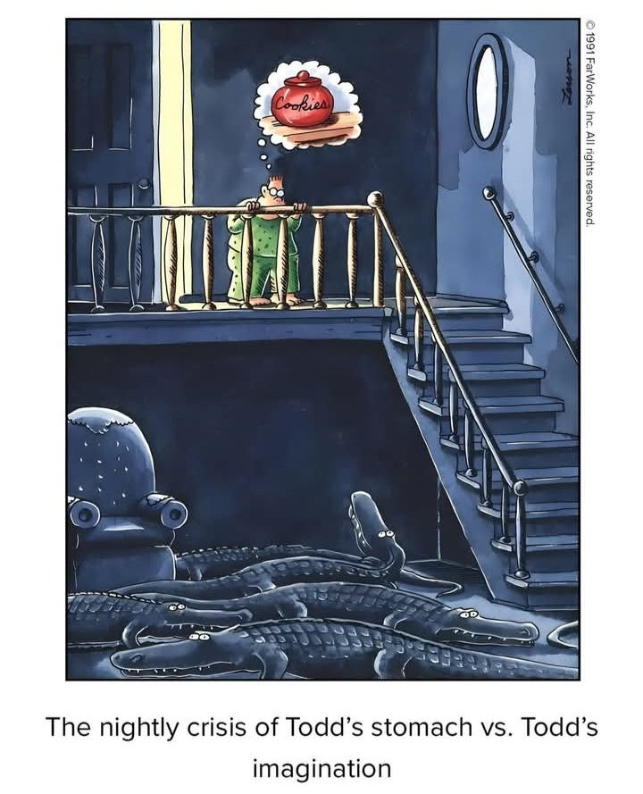

Slide 15
bibliography
Bissonette, Melissa Bloom. “Teaching The Monster: Frankenstein And Critical Thinking.” College Literature, vol. 37, no. 3, Summer 2010, pp. 106-20.
Cardozo, K.M.(2006) Demystifying the dissertation, pp. 138-154 (17 pages) https://www.jstor.org/stable/25595837
Emerson at al (1995) Writing Ethnographic Fieldnotes. The university of Chicago Press Ltd. London
Meliac, E. (2018) The Monster and the Humanities. The Creation of a Pedagogy for the Humanities in Mary Shelley’s Frankenstein; or, The Modern Prometheus

